Slide 1
Banking Data Mining Case Study
João Pedro Dias – ei11137
Jorge Santos – ei11057

Slide 2

CRISP-DM

Slide 3
Business & Data Understanding
Business is based of operations in any regular bank such as transactions, clients, credit cards and loans.
Analysis of data tables relationships
Understanding the attribute’s “names” and their meaning
Understanding the attribute’s content meaning (possible values of each attribute like the range and type)

Slide 4
Data Preparation
Renaming attribute’s names for more meaningful keywords.
Spreadsheet “Demographic Data”
Extract implicit knowledge
Extract “birthdate” and “sex” from clients birth number
Extract client age from birth number
Eliminate incoherence provoked by empty files
District D69 had missing values that were replace by average value of all other districts
Retrieve useful information from “transaction” datasheet.
Ex.: Accounts with history of sanctions.

Slide 5
Descriptive data analysis

Slide 6
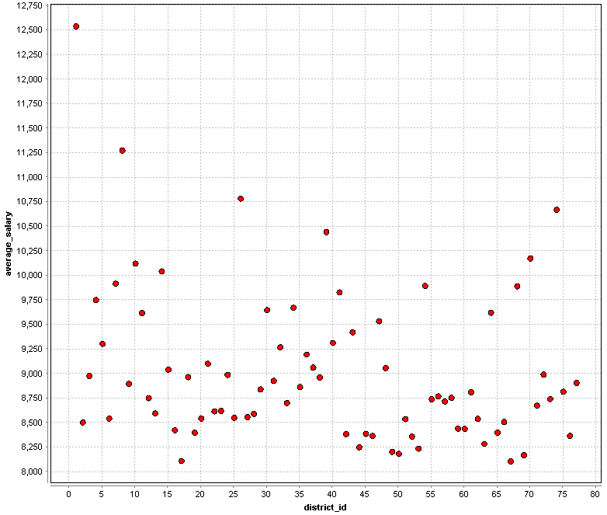
Salary data distribution
Data shows a large variance of average salary by district.

Slide 7
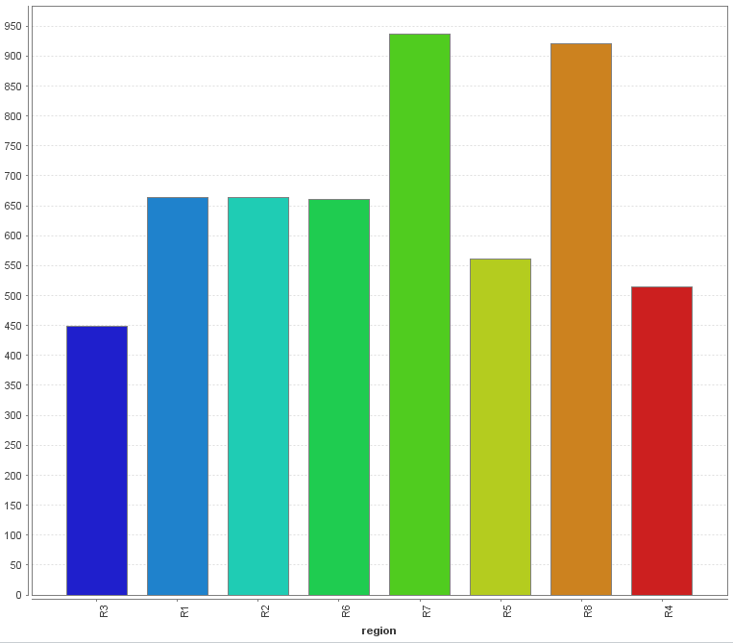
Number of clients per region
Data seams equal distributed by region.

Slide 8
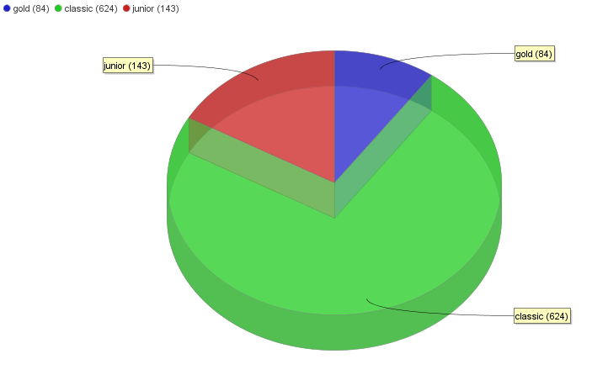
Card Type distribution
We see a big presence of cards of the type “classic” with a smaller presence of “junior” followed by “gold” cards.

Slide 9
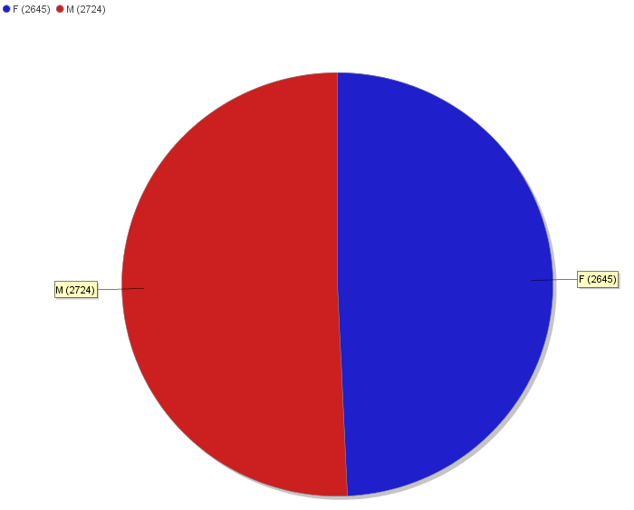
Clients gender distribution
Data seems equally distributed between genders, so seems there is no bias on gender.

Slide 10
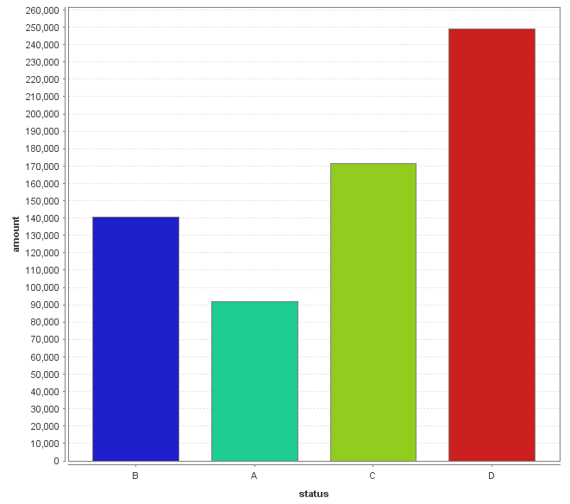
Loan amount distribution by status
We see a pattern that loans with larger amounts tend to be more risky with clients staying with debts (type B). On the other hand, clients with smaller loans tend to finish all the loans without problems (type A).
On running contracts, we see that larger loans tend to be more suitable indebting clients (type D).

Slide 11
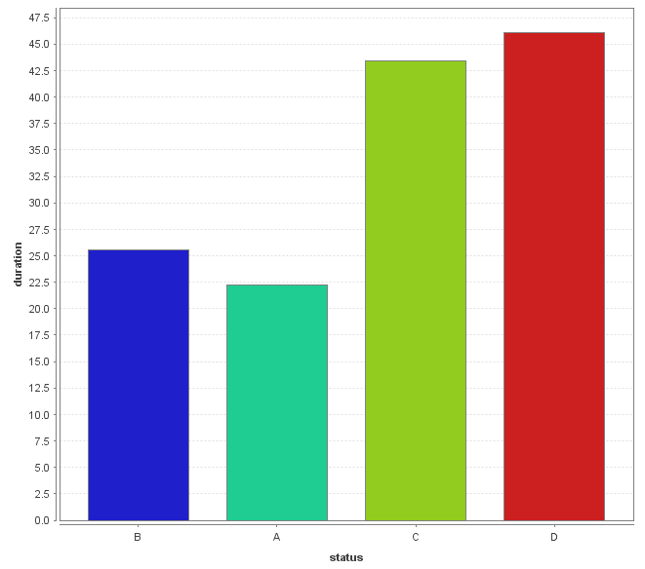
Loan duration distribution by status
We see a pattern that loans with longer durations tend to be more risky with clients staying with debts (type B). On the other hand, clients with smaller contract durations tend to finish all the loans without problems (type A).
On running contracts, we see that longer duration loans tend to be more suitable for indebting the clients (type D).

Slide 12
Clusters
We took on several data tables that’s seems to have useful data for creating clusters of clients in a way that the bank can target any of these clients with specific campaigns (for example marketing).
For this proposed we used k-means RapidMiner operator with the measure type set to “MixedMeasures”

Slide 13
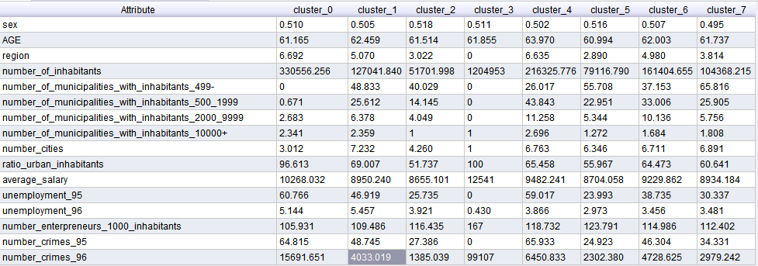
Client / Demographic clustering
We opted to generate 8 clusters due to the large amount of demographic data existent.
The clusters show a main division by number of inhabitants but influenced by all the other fields too.

Slide 14
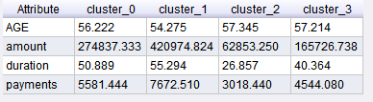
Loans / Clients Clustering
It is evident the relations between the loan amount and its durations in each cluster, so it seams a good clustering example that clients with same behavior fall in the same cluster.

Slide 15
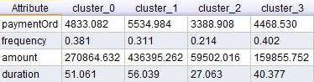
Permanent Orders & Loans / Clients Clustering
It seems to be a correlation between a low frequency of issued statements of an account and smaller amounts of each loan and each permanent order done by that account.

Slide 16
Predictive data mining

Slide 17
Data problems and applied solutions
We had a small dataset of finished loans (loans with status A or B)
Around 234 loans.
Recurrent overfitting the model.
Modification of (pre)pruning parameters.
Ignoring of irrelevant attributes.
We opted for not using any date related field because that would make the model unsuitable for future predictions.
We opted to not use gender as a decision variable too.
There isn’t a good distribution of loans by status.
The majority of the current loans are of type C and finished loans of type A, difficulting the prediction of bad indicators for loans.

Slide 18
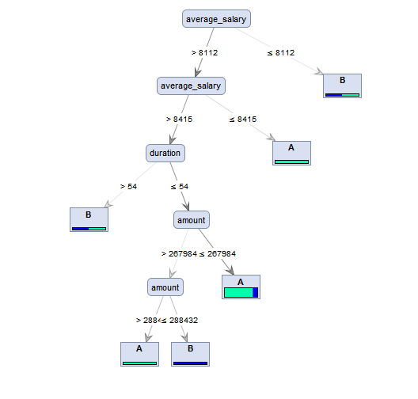
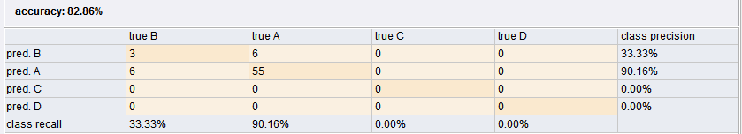
Decision tree for predicting successful loans
We come to the conclusion that the most influencing attributes for loans success or failure are “average_salary” of clients demographic data, “duration” and “amount” of the loans.

Slide 19
How we reach this solution?
Rapidminer
Using split validation operation:
70% as training data and 30% as testing.
Using Decision tree operator:
Using pruning:
Confidence 25%
Using pre-pruning:
Minimal gain of 5%
Use of data tables:
Clients, Account, Loans, Demographic

Slide 20
Decision tree for predicting successful loans based on finished loans only
We come to the conclusion that the most influencing attributes for loans success or failure are “average_salary” of clients demographic data, “duration” and “amount” of the loans.

Slide 21
How we reach this solution?
Rapidminer
Using split validation operation:
70% as training data and 30% as testing.
Using Decision tree operator:
Using pruning:
Confidence 25%
Using pre-pruning:
Minimal gain of 5%
Use of data tables:
Clients, Account, Loans, Demographic

Slide 22
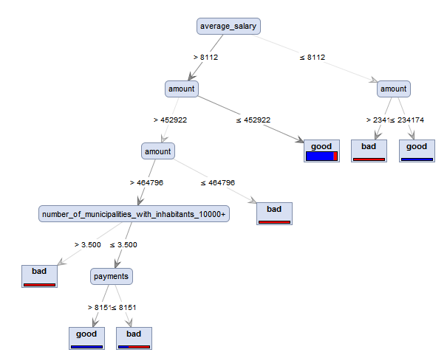
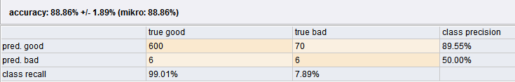
Decision tree for predicting successful loans based on finished and active loans
We come to the conclusion that the most influencing attributes for loans success or failure are “average_salary”, “number of municipalities with inhabitants above 10000” of clients demographic data, “payments” and “amount” of the loans.

Slide 23
How we reach this solution?
Rapidminer
Using x-validation operation:
Number of validations: 10
Using Decision tree operator:
Using pruning:
Confidence 25%
Using pre-pruning:
Minimal gain of 4%
Use of data tables:
Clients, Account, Loans, Demographic

Slide 24
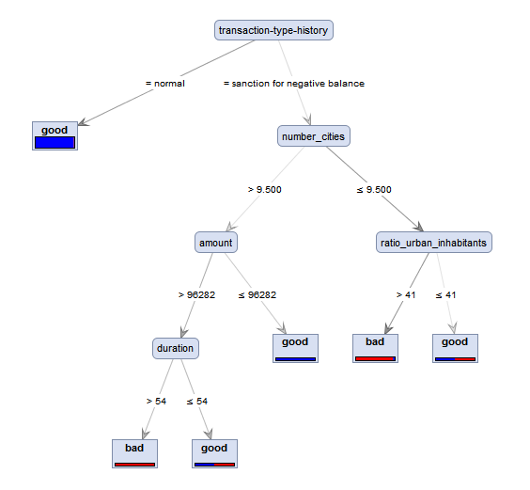
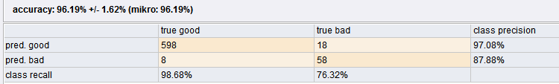
Decision tree for predicting successful loans based on finished and active loans and transaction data
We come to the conclusion that the most influencing attributes for loans success or failure are “number of cities”, “ratio of urban inhabitants” of clients demographic data, “duration” and “amount” of the loans and account transaction’s type history.

Slide 25
How we reach this solution?
Rapidminer
Using x-validation operation:
Number of validations: 10
Using Decision tree operator:
Using pruning:
Confidence 25%
Using pre-pruning:
Minimal gain of 10%
Use of data tables:
Clients, Account, Loans, Demographic, Transactions

